Slide 1
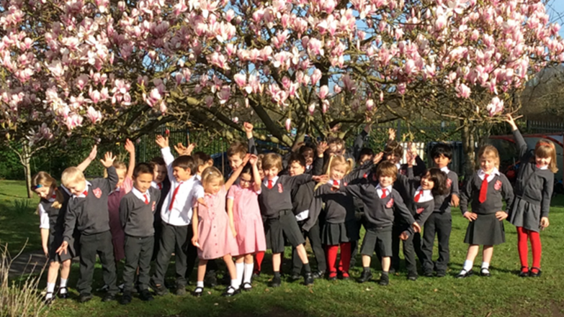
Welcome Meeting
Notes:
Introduction by TH
Welcome to St Joseph and St Teresa
Tonight will give you chance to
Meet the staff
Hear about the daily routines in the class
Understand the curriculum expectations
Find out how you can support the learning
Ask questions
Introduction
Ruth Thompson who will teach on Monday, Tuesday and Wednesday , Emma Dolman who will teach Thursday and Friday and Mel Clark our teaching assistant.

Slide 2

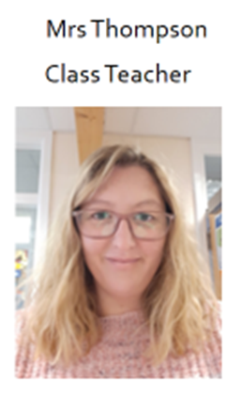
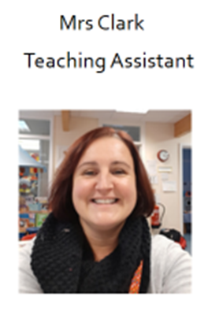
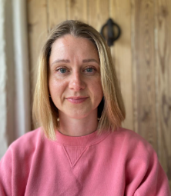
Mrs Dolman
Class teacher
Nightingale
EYFS
Year 1
Einstein
Year 1
Year 2
Shakespeare
Year 2
Year 3
Rosa Parks
Year 4
Year 5
Malala
Year 5
Year 6
Notes:
Welcome to the school family.
Good evening to some returning faces, who have had children learn in Nightingale class before and a very warm hello to some new families.
I’m Ruth Thompson, I’m the Early years lead. I’ve been teaching for over 20 years and have been here for 11 years. I have 3 children, one who is currently at this school and my eldest are now at the Blue School. I am passionate about child development and I absolutely love teaching this age group because they are such sponges and become so excitable about learning.
Emma-
There are 5 classes within the school, each with a mixture of ages – at present the numbers of pupils in each class hasn’t been finalised, however as a guide there are 29 pupils in our current EYFS/ Year 1 class

Slide 3

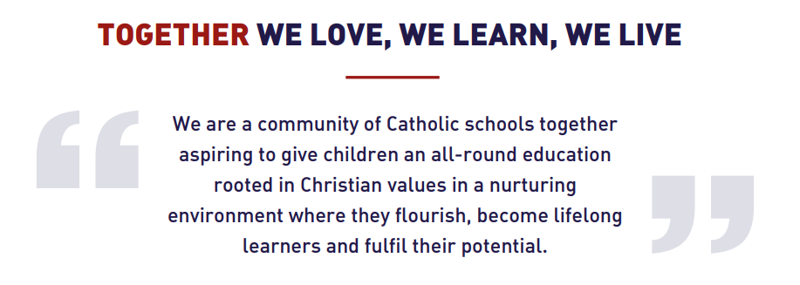
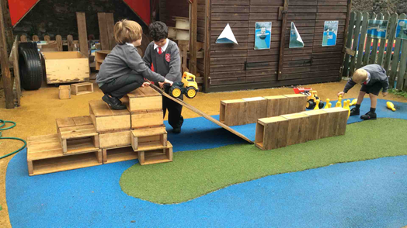
Notes:
Our school is part of the Catholic Education Trust. We are a group of schools that work together.
We share the values on the right, which we weave into our teaching and encourage the children to talk about daily.
Each week we celebrate the children who working hard to live by these values.
However our main aim is that the children are happy, feel safe and enjoy learning though play.
We also aim to work in a partnership with families, to have clear lines of communication so that the pupils achieve their potential. So thank you again for coming tonight to start this journey.

Slide 4
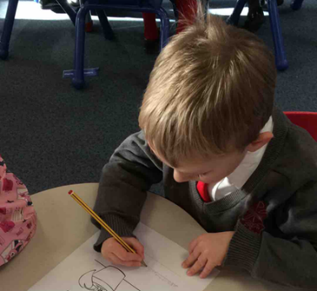
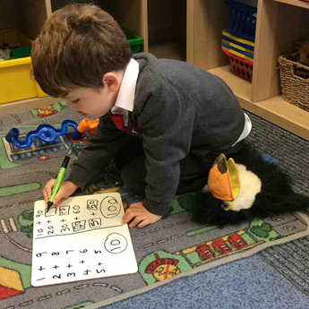
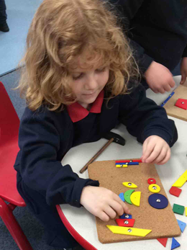
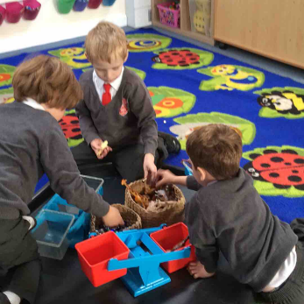
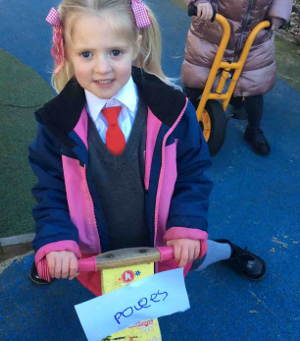
A Typical Day
8.35 | 8.50 | 9.10 | 9.30 | 9.45 | 11.20 | 12 | 1.00 | 1.15 | 3.00 | 3.15
Arrive Self register | Celebration of the word | Phonics | Whole class session 1 | ITMP | Whole class session 2 | lunch | Whole class session 3 | ITMP Group tasks | Story | Home
Notes:
Our school day starts at 8.35am when the doors open for children to come in to class. The aim is for children to do this independently so to guide them through this process staff will meet the class on the playground and lead them inside. Parents do not come in with the children, if you have information to pass on to staff this can be done through the member of staff on the playground in the morning, by phone or email.
Self registration- The children organise own belongings, find their name cards and hand in letters and reading books. It takes a few weeks to get the routine in place, but we encourage every child to do this independently!
The class join the whole school 3 times a week for celebration of the word
Phonics- We split into single year groups for this session and follow the Little Wandle Scheme, which we will look at later.
We have 3 -4 whole class sessions a day. They are short to begin with but gradually get longer as stamina builds throughout the year.
Typically the morning sessions are based around early reading and writing or mathematical activities.
ITMP time is our largest portion of the day (during this time, pupils direct their own learning. Staff interact with all pupils, build relationships, develop language skills, engage and extend the learning, promote new opportunities, provide resources and learn through PLAY!)
We don’t stop for a morning play but a snack café is open all day for the children to have fruit and water.
Lunch is at 12. After they have eaten the play in the large playground with the older pupils. The older children are extremely nurturing towards the younger children and help them learn lots of playground games.
The afternoon begins with a whole class input (RE, Geography, History, science, art, DT, music, science, PHSE, computing or PE)
This is followed by group activities based on the whole class input as well as when staff listen to the children read
The day usually ends with a story. Throughout the day we aim to read at least 5 stories, songs or poems each day.
At 3.15 the children will be handed over to you in the playground. We will do this one at a time, which can take a while to get used to. If your child comes over to you without us sending them, please can you send them back to wait in line!
You will have noticed that the day has a mixture of adult led sessions (either, whole class or group work) and large sections of the day where the children direct their own play. It is this purposeful play that make the early years different from the rest of the school.

Slide 5
The EYFS Curriculum and purposeful play
Area | Strand | Early Learning Goal
Prime Areas | Communication and language | Listening, Attention and Understanding
 |  | Speaking
 | Physical development | Gross Motor Skills
 |  | Fine Motor Skills
 | Personal, social and emotional development | Self-Regulation
 |  | Managing Self
 |  | Building Relationships
Specific Areas | Literacy | Comprehension
 |  | Word Reading
 |  | Writing
 | Mathematics | Number
 |  | Numerical Patterns
 | Understanding the world | Past and Present
 |  | People, Culture and Communities
 |  | The Natural World
 | Expressive arts and design | Creating with Materials
 |  | Being Imaginative and Expressive
Notes:
The reason this reception year is different to the rest of the school is because it is designed to prepare the children to be ready for year 1. The flexible- learn through play style enables adults to scaffold the learning to each child's differing needs.
The children come to school from a wide range of starting points and personal experiences.
Through ITMP, staff play alongside the children, monitor their progress and tailor their playful learning to ensure progression is specific for them. The staff work hard to ensure the interactions that they have with individual pupils reflect their growing needs and interests.
Alongside this freer aspect of the day, a carefully preplanned curriculum is taught in whole class lessons to make sure that the children are taught the skills and knowledge to meet progression milestones throughout the year.
The EYFS framework is split into 2 key areas, prime and specific.
The Prime Areas are basic, life-long skills that pave the way for children to progress towards Specific Areas of Learning.
The Specific Areas of Learning cannot be developed alone, and rely on the skills gained in the Prime Areas of Learning.
These are split into 7 strands.
These strands are broken down further and it is on these which we will base our end of year report. There is an Early Learning Goal descriptor for each of these 17 areas and when we meet to discuss your child’s progress, we will let you know if they are on track to meet these.
Staff scaffold and support those who need a little extra help and provide challenge for those who can be extended further.

Slide 6

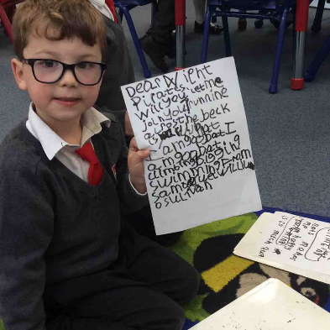
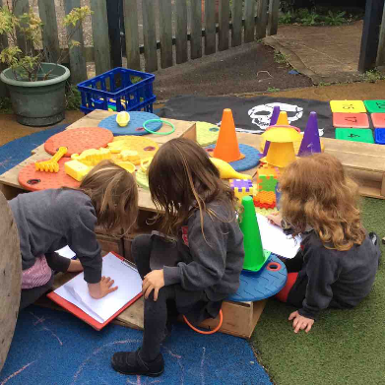
Evidence Me
Wow moments!
A quick note or picture of new learning
ITMP – observations
Details of how your child has been supported and what they are learning to achieve.
Notes:
We like to keep you informed as to your child’s progress. One of the ways we do this is through an app called Evidence me. If your child’s preschool uses tapestry, it is very similar.
We may send you two types of notifications on this platform.
A wow moment – this is a quick snap shot to share something, fun, interesting or new that your child has done.
ITMP – this is a more detailed observation which shares what your child was doing, how their learning has been extended by a member of staff and what they can now do as a result. This type of observation may also include information about how you can further this at home.
We ask that you log onto Evidence Me to send us wow moments from home. The teacher assessment that we make at the end of the year take into account the views of school staff, pupils and parents so your input into this is much appreciated. For example, if your child has learned to ride a bike on the weekend, or if your child has taken up a new club or started a new hobby, we would love to talk about this with them and celebrate their success.
You will find that we use Evidence Me mainly during the Autumn and Spring Terms, and less during the Summer Term when the children are working more on paper, and transitioning to year 1.
If your child is in a preschool that sends updates, you may find they get fewer updates from school. Please be reassured, this is purely due to the staff pupil ratio, your child will be very busy in school!

Slide 7
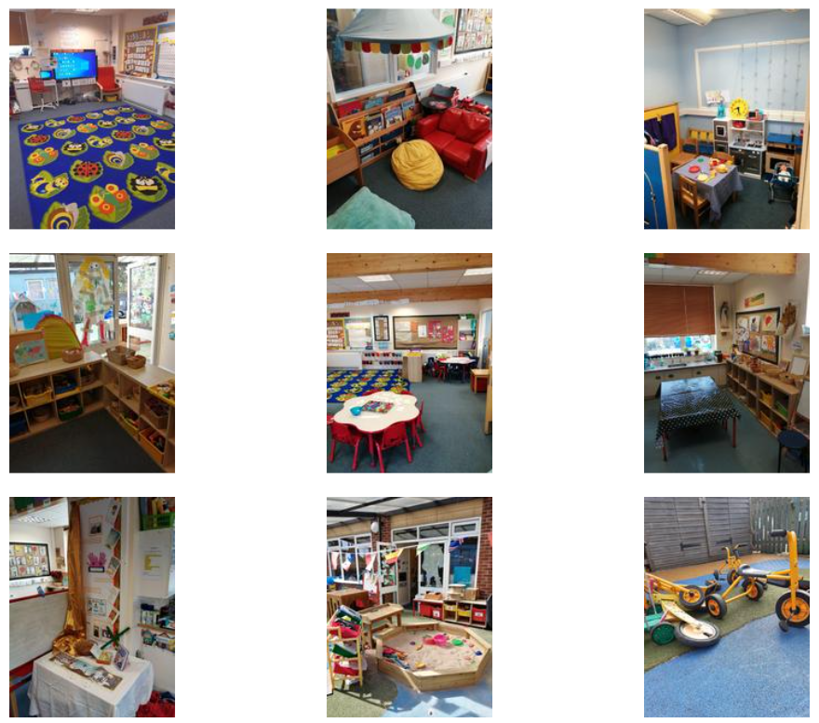
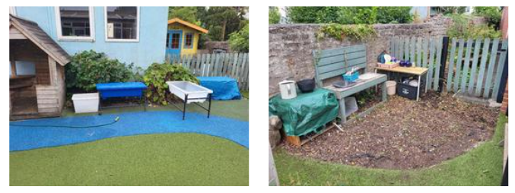
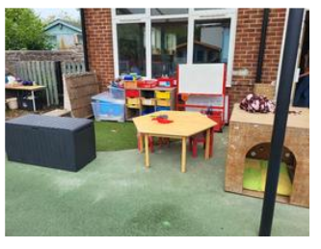
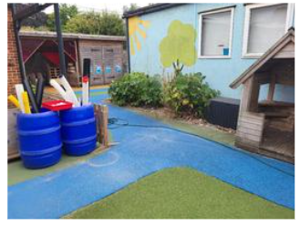
The Environment
Notes:
For those that wish, we will go to look at the classroom space at the end of the presentation.
The children will have access to the both inside and outside during the ITMP sessions. Each zone has a mixture of resources that promote progression across each of the 7 strands of the EYFS framework. We up skill the environment gradually throughout the year so that it provides more challenge towards the summer term. We also adapt the environment based on the children’s current interests.
Your input into this is really helpful. Each week we choose a few children to focus on and we record our observations of these pupils during the ITMP time. We still spend time with all pupils, but record the learning for just a few children each week.
Before your child’s half termly focus week, we send home a form asking about your child’s current interests and recent achievements. Please send this form back as swiftly as possible as it helps us prepare the environment with them in mind.
Also, occasionally parents are able to donate resources that can enhance our provision- hosepipes, gardening tools, plants and seeds, junk modelling resources, large sheets, tarpaulins, pots and pans for the mud kitchen etc. It’s always worth asking if you think you have something we might be interested in!

Slide 8
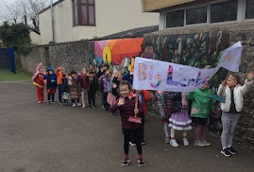
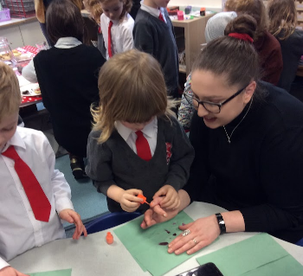
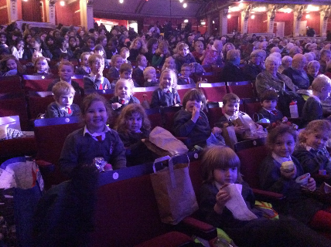
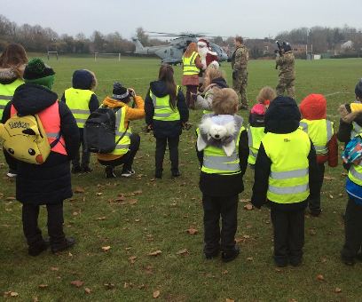
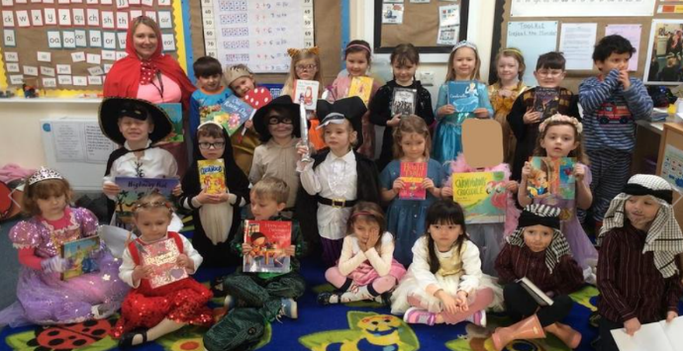
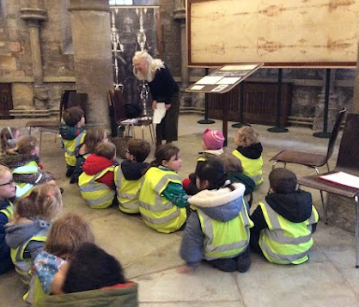
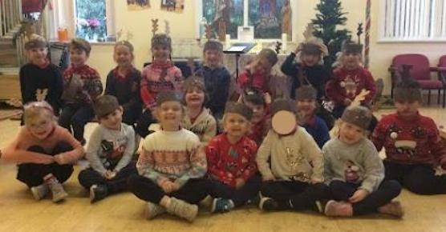
Life experiences
Notes:
In addition to all the regular classroom based learning opportunities, we like to offer lots of life experiences such as trips to the theatre, visits from Father Christmas, parent share afternoons, charity walks, and walks in the local area.
Each week the children take part in forest school, led by our forest school leader, Mr Trowga.
On Wednesday’s, the children come to school wearing their home clothes. These need to weather appropriate and cover their arms and legs. They take part in forest school activities in all weathers and can get dirty! We will provide overalls but they will need to keep a pair of wellington boots in school. On warmer days we ask the children to bring shorts and t-shirts to change into after.
PE happens each Friday and again, the children come in their kit to school. They can wear trainers, but please make sure that they can fasten these themselves. When they move to year 1 they will bring their PE kit to change into in school.
The children will meet a lot of staff and volunteers throughout the week including Mr Ring and Mrs Viv who prepare our hymns for regular worship in church. The school Masses will be advertised in the weekly newsletters, please come and join us at Mass. You do not need to be Catholic to do so, everyone is welcome.
We love having volunteers/ parents/ grandparents help with trips or come into school to talk to the class about their professions. If you feel that this is something you would be interested in, please let us know.

Slide 9

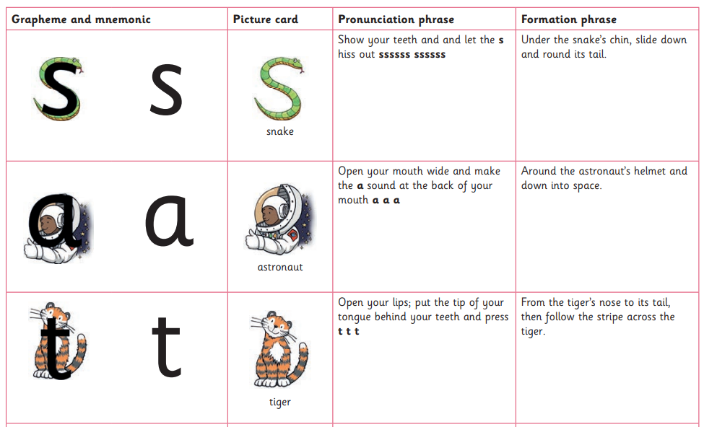
Phonics
Notes:
In the Autumn term, you will be invited to a parent workshop to learn more about early reading, writing and number.
We start phonics lessons in the first week. There is a 20 minute phonic lesson every morning. The progression of the scheme is rapid, so to help the children keep pace we ask for parents to support the learning at home for 5 minutes each day.
We will send home a bag with a few sounds cards and tricky words to look at together. Each Friday the children hand these in to be topped up with the weekly sounds.
As the scheme gets harder, the children are encouraged to read short words by blending the sounds together. Once they can blend confidently the children will begin to bring a reading scheme book home in addition to their bag of sounds and tricky words. Again, just 5 minutes each day is enough to make a huge difference.
There is more information about our scheme on the school website or by visiting Little Wandle Letters and sounds.
Please try to join us for the parent workshop in the workshop when the date is advertised.

Slide 10


Google Classroom
Notes:
Google classroom is used for several reasons and we ask all pupils to get set up with this swiftly in the autumn term. The school will create the account for your child and invite you to join in September.
We use GC as a way of sharing a weekly class update, or whole class achievements with all the class. We attach photographs of the children (if you have given consent for your child’s picture to be used) but ask you not to share these with anyone else as they may contain photographs of other children. Comments made on the class stream are available for the whole class to see.
We also use this as our platform for setting and handing in homework.
Homework will be either be a short practical task for you and your child to enjoy together to reinforce the learning that has taken place in class or it might be a fun project to complete by the end of the term. We ask that you submit a photo of the learning and add a short message if you wish. Comments made when you submit homework will only be seen by school staff. Like Evidence Me any photos and comments linked to home learning will contribute toy your child’s EYFS profile.
Downloading the app onto your phone or tablet is a good way to get the notifications when they pop up.
Please join the Instagram group or find us on Facebook too!
In September, you will be asked to complete a photo consent form to say if you are happy for us to out your child’s picture on social media. We will not do so unless you authorise this.

Slide 11
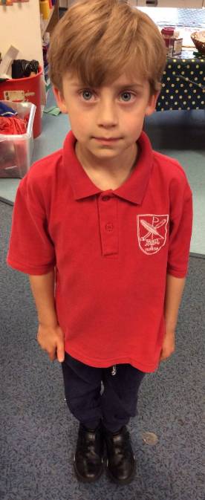
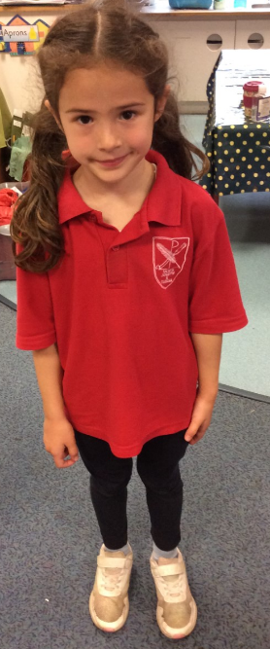
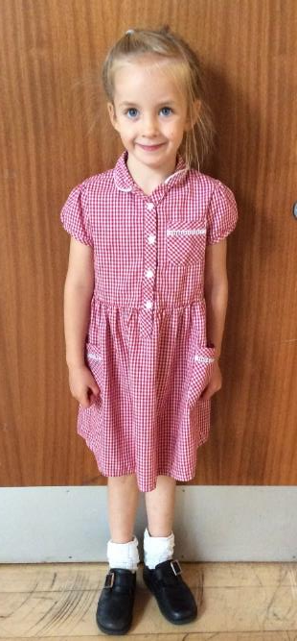
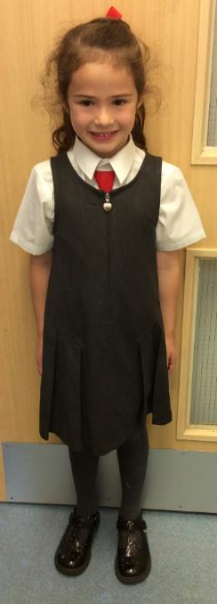
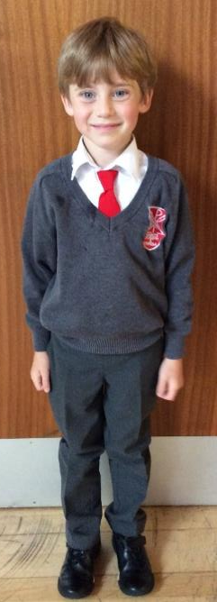
Uniform
Notes:
The full list of uniform available on the school website
The items with the school logo on will need to be purchased from Southwest School Wear in Wells
The Jumpers and PE shirts have the logo but everything else can be bought from your own choice of shops.
There is a winter and summer uniform but both require black school shoes
The winter uniform has a tie, we recommend getting a tie on elastic. They might want to practise wearing this before starting!
When you start, you can wear either uniform. Usually, the children move into winter uniform around October half term, although it depends on the weather. We do ask that the 2 uniforms are not mixed and that tights are worn with the winter uniform only. Tights can be grey or red. Boys can wear shorts in the summer. We recommend short sleeve shirts as it is much easier for messy play.
The children will come into school in their PE on Fridays. They can wear navy shorts, leggings or jogging bottoms. If they are wearing trainers please make sure they can take them on and off independently – Velcro is best!
Your child is going to need a warm coat, that is waterproof. We encourage the children to go outside in all weathers!
They will also need a bag – this is useful if it has a section for a water bottle on the outside, to help protect their reading books from leaks! Also, it needs to be big enough to fit a large picture book as they will be bringing a book from our Library home regularly. The red bags that the unform shop sell are ideal. Any bag needs to be clearly identifiable with ribbons or keyrings.
Hats and gloves are needed in the winter and sun cream and sun hats for nicer weather. These are the items that get lost most easily, so please name everything especially shoes and jumpers.
Hair longer than shoulder length should be tied back.
Wellington boots are needed to be kept in school for using the mud kitchen and forest school.
On non uniform days or forest school days, please consider your child’s foot wear. They need to be able to put on and fasten their shoes as independently as possible! 30 pairs of laces takes a long time to do!
WRITE YOUR CHILD’S NAME ON EVERYTHING!!!!

Slide 12

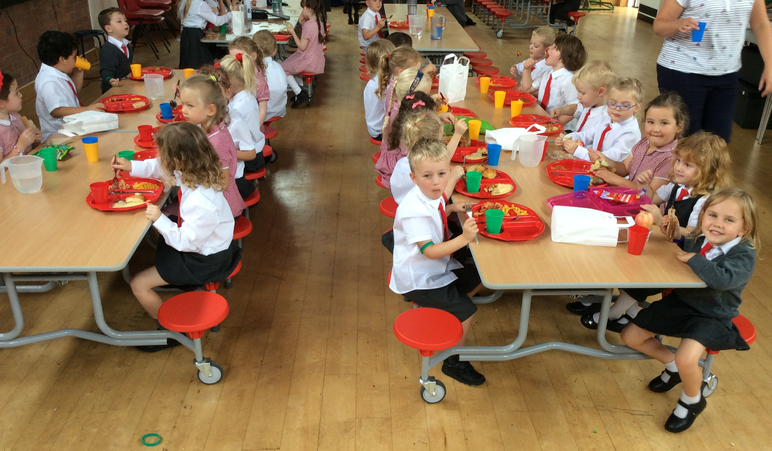
School dinners
Notes:
Dinners can be ordered using the School Gateway App from midday on September 2nd.
Please download the app in readiness, there are links and instructions in your packs.
Unfortunately, you can not start using the app until term begins in September but it’s a good idea to get this ready to do as you will only have a short time to get dinners ordered for the whole term.
We are coming home visits in on Thursday 4th and Friday 5th. So if there are any issues logging in and ordering dinners ready for the 8th, we can sort this together.
Each day there is a choice of a main meal, vegetarian alternative, sandwich or jacket potato. Gluten free and vegan options are also available.
Meals come with a pudding
All meals are free for pupils up to the end of year 2
You can choose to bring a packed lunch from home if you wish.
Meals from school or home can be mixed throughout the week.
There is a full list of allergens available if you require this.

Slide 13
Wrap Around Care
MEdwards@sjt.thedcet.com
Breakfast Club From 7.30 am Monday – Friday
8.00am-8.40am £6.50
7.45am- 8.40am £7.00
7.30am -8.40am £8.50
After School Club
Available from the end of the school day until 5.30 pm, Monday - Friday.
After school can be booked in 15 minute blocks at £1.75 per 15 minutes / £7.00 per hour.
Notes:
Breakfast club and afterschool club can be booked through the Gateway app, once you are on the school system in September
Breakfast Club
7.30 am Monday - Friday, where they will be offered breakfast and a pleasant introduction to the school day. They will be escorted to the playground when it is time to line up.
After School Club
Available from the end of the school day until 5.30 pm, Monday - Friday. Your child will be collected from their class at the end of their school day, and taken by staff to our 'wrap around care'. Children are offered biscuits & toast and can have fruit and milk if they wish
All information is on the school website in the additional information for parents tab
In the meantime if you need to book for the first week please use the email address on the screen

Slide 14

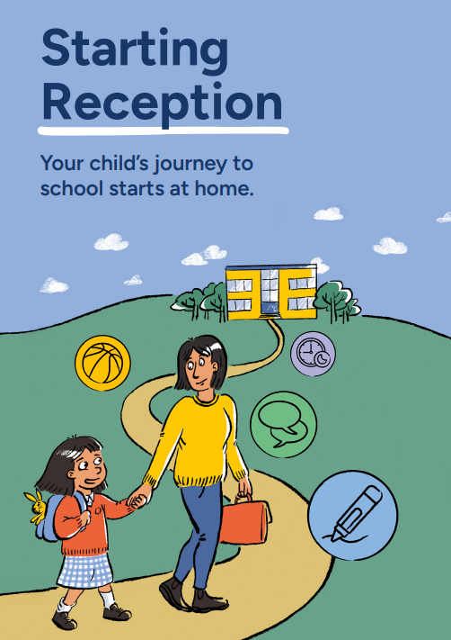
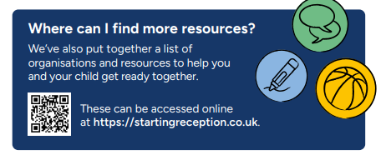
School Readiness
Notes:
There is no need to start schooling your child for school!
New skills take time to learn. Practising at home will help your child move into school more easily and with confidence.
Taking care of themselves
Putting on/taking off their coat and using the zip
Using the toilet and washing their hands
Getting dressed with little help, e.g. after using the toilet or doing PE
Putting shoes on the right feet, including wellington boots
Using cutlery and drinking from an open cup
Opening and closing own snack tubs
Putting their water bottle in their bag
Zipping up a bag
Spending time away from you, learning they can be looked after by caring adults
Play, creativity and curiosity
Taking part in imaginative play (e.g. role play)
Drawing, painting, colouring and sticking
Sharing story books with an adult, looking at pictures and talking about the characters
Exploring the world around them (e.g. looking closely at the natural world or playing safely with objects at home)
Being with others
Practising sharing and taking turns with toys
Talking to them about how they are feeling and why - looking at story books together and speaking about what characters are feeling is a good way to do this
Beginning to recognise what others are feeling, e.g. understanding if a friend is sad
Encouraging them to set boundaries for themselves and others (e.g. knowing how to say ‘no’)
Playing games and not always winning.
Communication and language
Singing along with songs and nursery rhymes
Talking happily to others about activities, experiences and the world around them
Showing they need help by speaking clearly (in basic English or sign language)
Recognising the pattern of their name (so they can find it on their coat peg or jacket)
Saying please and thank you
Engaging in extended conversations- never as a child a question you know the answer to!
Listening and engaging
Knowing when to wait if someone is talking.
Paying attention for short periods of time on practical activities
Listening to and following simple instructions.
Carrying on with a task even when it’s difficult and bouncing back if things go wrong.
Physical development
Getting moving for at least three hours a day
Climbing, running, jumping and playing
Catching a large ball (most of the time)
Doing simple puzzles and craft activities, strengthening their grip with cutting and sticking
Preparing for a tripod pencil grip- start with activities that strengthen the shoulder and whole arm – sweeping, wheelbarrow races, climbing , hanging,
As well as finer skills such as , playdough, using pegs, scarf scrunching races, threading and using scissors.
Healthy routines
Going to bed around the same time each night, waking up in time to get ready for school
Limiting screen time to the recommended daily amounts (see advice)
Eating a healthy diet and trying new foods
Brushing their teeth with fluoride toothpaste twice a day (you’ll need to supervise this until they are at least 7)

Slide 15
Dates
Wednesday 25th June 9.30 – 11am - Settling session 1 (Explore the classroom)
Wednesday 2nd July 9.30 - 11am- Settling session 2 (Meet more friends)
Wednesday 9th July 9.30 – 11am- Settling session 3 (Forest school)
Tuesday 2nd September – INSET day- no school
Wednesday 3rd September – INSET day – no school
Thursday 4th September – No school for Reception pupils due to home visits. All other pupils are in school
Friday 5th September – No school for Reception pupils due to home visits. All other pupils are in school.
Monday 8th September – First day of school 8.35am- 3.15pm
Notes:
Settling sessions:
Please let us know of any medical needs and allergies before the settling sessions
If you are not going to be able to attend the sessions, please email me RThompson@thedcet.com so that I know who to expect.
Home visits
Thank you to those who have signed up for a home visit in September when you arrived today. If you haven't signed up yet, please come and see one of us and we can do that this evening. Once everyone has signed up I will email you to confirm your visit.
In your pack …
Universal School meals forms – If you’re not sure if this applies to you, fill it in anyway as it may enable us some funding!
Data form to be returned ASAP- please say if one parent’s home language is not English as we can apply for English as an additional Language funding. Your child may be given a little extra support in class if they require it, or alternatively they may not need the support, but the funding still supports the school.
Evidence me form to sign up for the regular photos and updates about your child’s learning
All about me booklet. Please complete this and return it to school at any of their transition sessions. This will help us prepare the classroom over the summer with their favourite toys or items that may help the children settle more quickly.
Advert for a free maths APP
Safer screens poster
School Gateway log in details
I’m aware that we have given you a lot of information tonight. So if you have a question, even if you think we’ve already talked about it, please ask one of us after the presentation.
We will move to the classroom for you to have another look around and ask questions and you can sign up for your home visit there too.
Tour of the class / questions/ home visit form

