Slide 1
Our journey to live simply
By St Joseph and St Teresa’s school
Wells

Slide 2
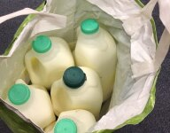
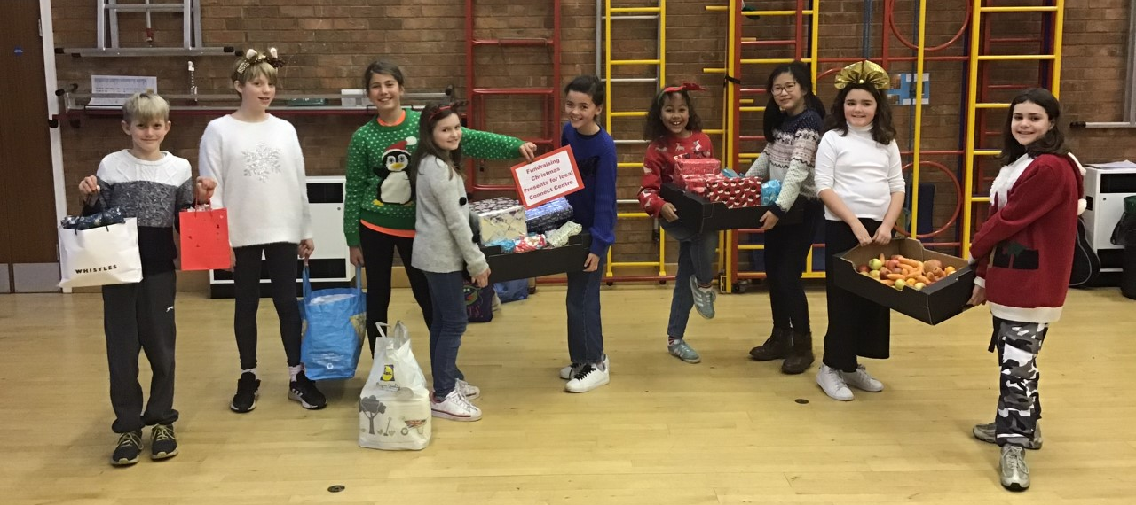
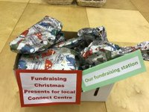
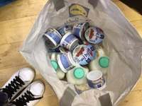
Not wasting food, collecting items for local food bank
We donated surplus food to the local Connect centre (a centre to help disadvantaged families)
Our children helped to collect food that was not required during lunch. They even encouraged the younger children to follow their example by not putting food into bins, but eating it or collecting it for people who are less fortunate.
By doing this, we collected 5 boxes, full of milk, yoghurt and fruit to help people who can’t afford it. Every Friday, one of our lunchtime supervisors takes a box full to the Connect Centre in Wells.

Slide 3

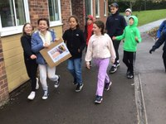

Our children regularly fundraise for CAFOD fast days. During our LIVE SIMPY journey they:
Raised money by doing ‘Walk Against Hunger’
Bought ‘Safe place to call home’ CAFOD World Gift with the money raised during Christmas Jumper Day
Supported Ukraine appeal last February when the conflict started
Are in the process of preparing for this year’s ‘Big Lent Walk’

Slide 4
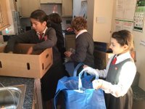
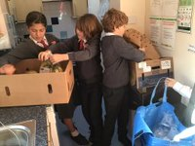
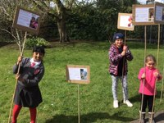
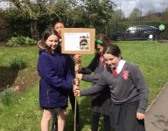
Reducing waste in our school
Our children worked hard and eventually our school was given different coloured boxes and bags to recycle various waste. We faced difficulties because our school’s main gate is in a small lane that can be tricky for a waste lorry to get to, but we managed and now:
Our general waste has reduced massively
The children learned what goes in which colour coded bag
Paper is being used only when absolutely necessary
We don’t use paper towels, but hand towels to dry our hands.
For art and general use, we use reusable cloths, made from cut up old t-shirts
We avoid using coloured ink, only using it when necessary
As you can see, in the pictures, our stations of the cross were made using cardboard boxes from fruit and bamboo sticks

Slide 5
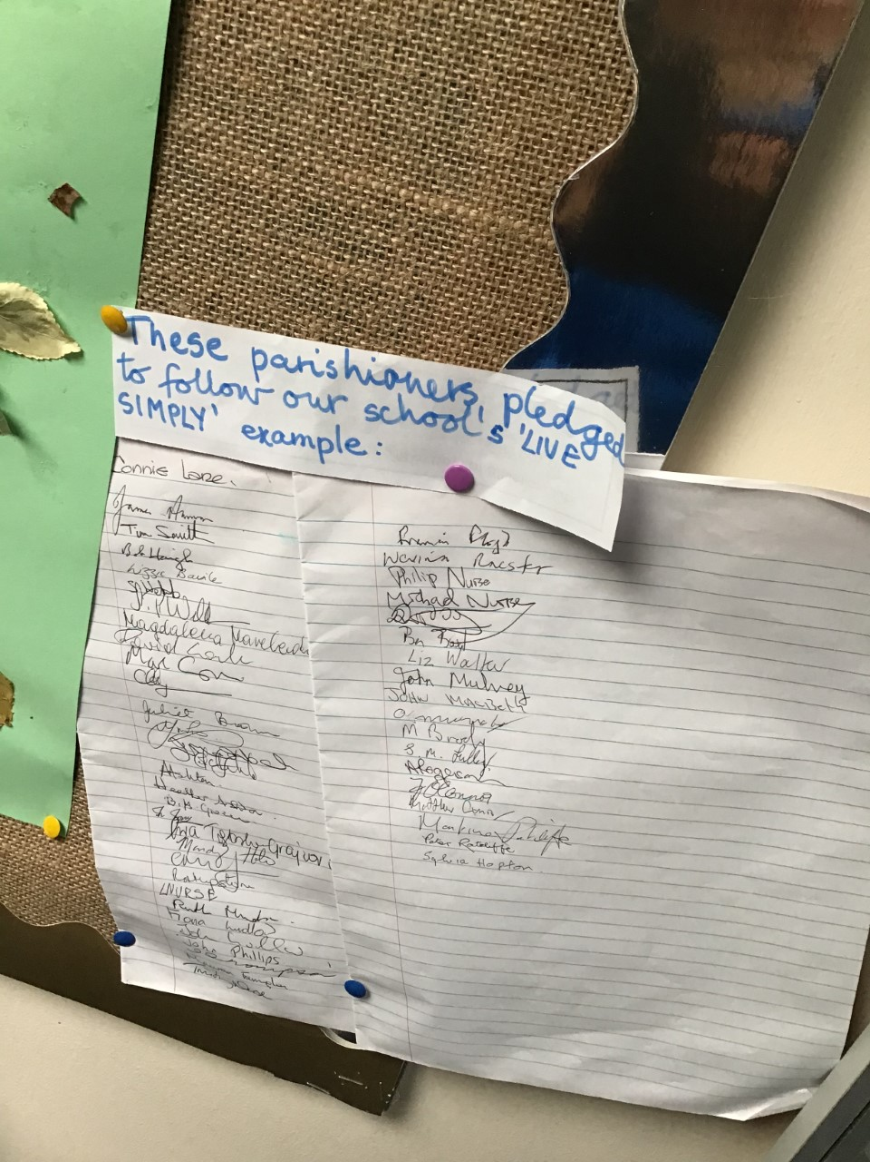
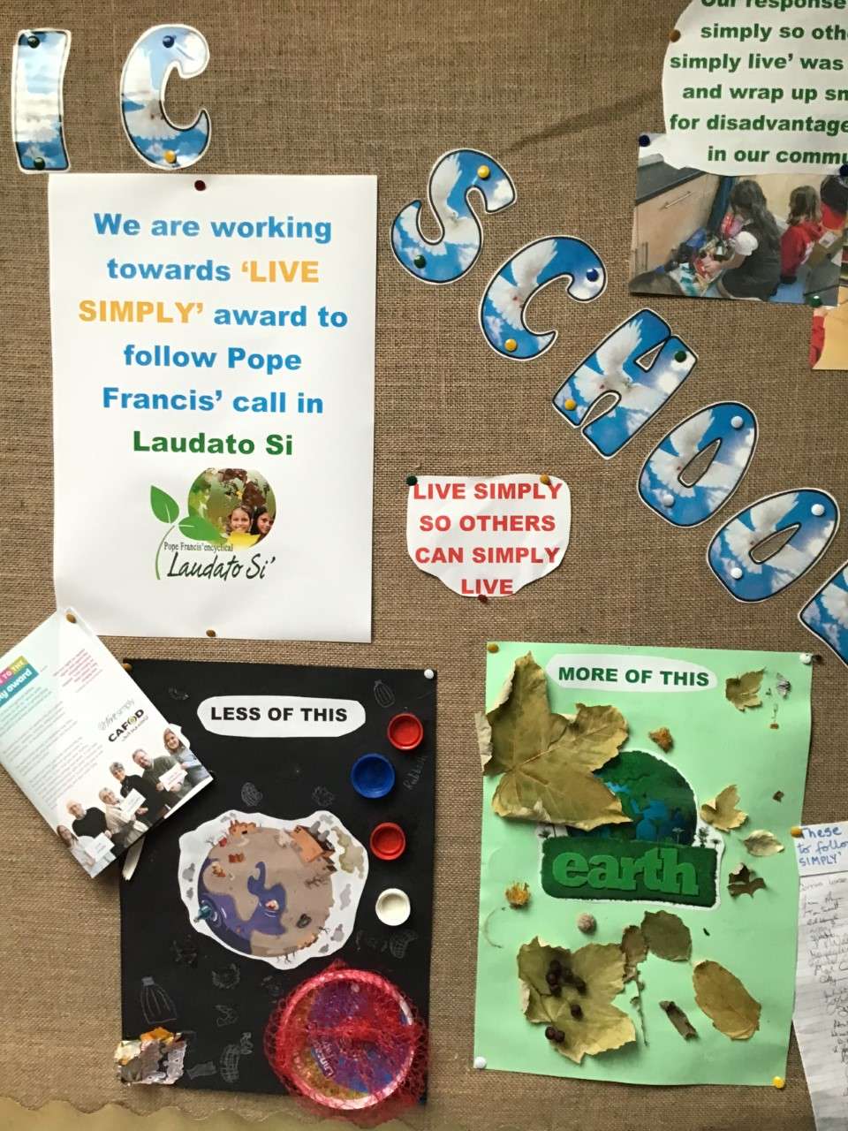
We pledged, to LIVE SIMPLY, together with our school and parish community
Some children, during a Youth mass, made a pledge and asked the parishioners to join in
We collected lots of signatures
Our school has successfully become an Eco school after lots of hard work, especially from one of our parents, Mrs White and one of our teachers, Mrs Hall
Our unused garden has been transformed into a prayer garden, dedicated to St Francis, where we grow lots of delicious raspberries and it has become a haven for wildlife
This has been the favourite part of the LIVE SIMPLY journey for our children.

Slide 6
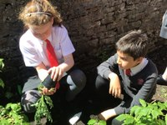
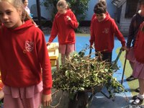
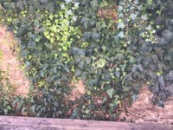
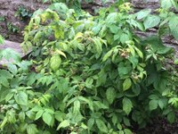
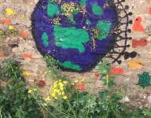
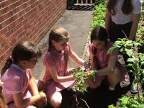
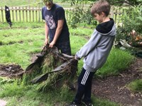
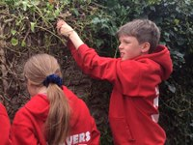
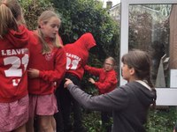
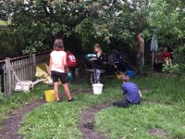
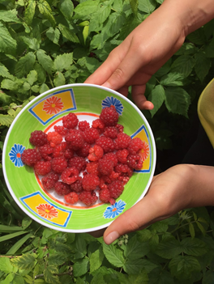
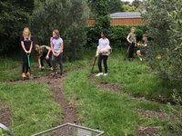
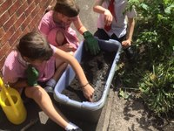
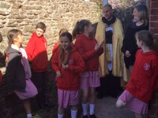
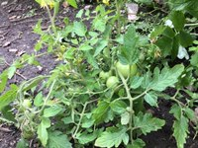
Our garden…

Slide 7
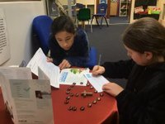
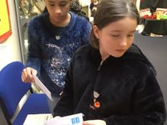
This is how our journey to LIVE SIMPLY started…
…by applying for LIVE SIMPLY award, filling in the forms
And we hope we will be recognised as a LIVE SIMPLY school

